Slide 1





GROUP: 495
TOPIC: WEB_STATEMENT
Teacher: Le Dinh Thuan
OUR TEAM
Nguyen Anh Khoa
2053134
Tu Mai The Nhan
2114277
Hoang Le Dong Ha
2210843
Nguyen Chi Trung
2213696
Huynh Huy Man
2433003

Slide 2

Overview
Introduction
01
Features
02
UI
03
Source code
04
Data structures and algorithms
05
Demo
06

Slide 3

Features
We design and implement a website for donation statements including filters based on a number of criteria - users can customize
Search keywords
Search Date Range
Search Amount Range
Users can search all transactions via keywords. Users just need to enter the information they want to search for in the input keywords box.
Searching by date will help users easily localize transactions to filter out the exact results they are looking for
Users can still search by price that we have fixed ranges or users can customize the price range they want to search for.

Slide 4
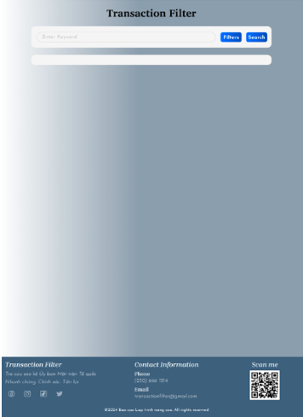
UI
Frontend: We uses html/css and javascript. Besides, we also use Boostrap to look better
boot interface

Slide 5
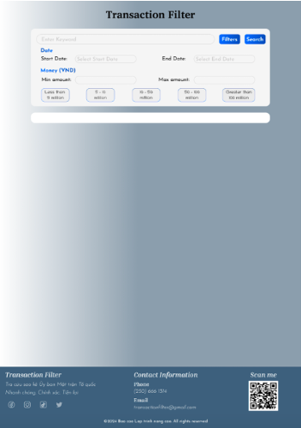
UI
Interface with filter features

Slide 6
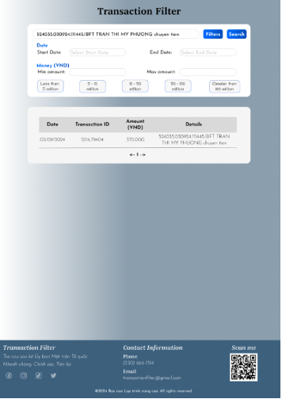
UI
Search results

Slide 7
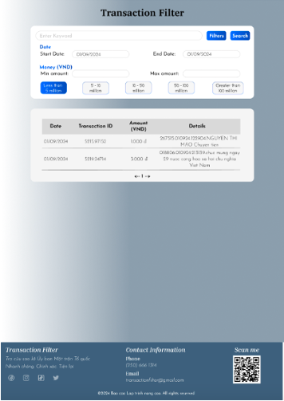
UI
Filter results

Slide 8
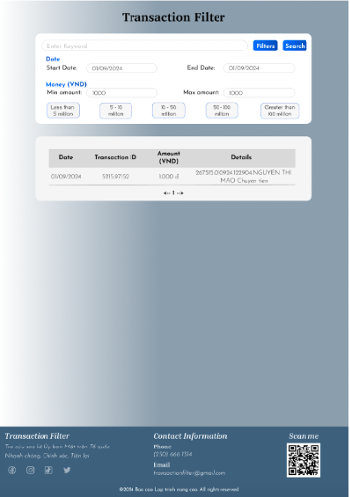
UI
Filter results

Slide 9
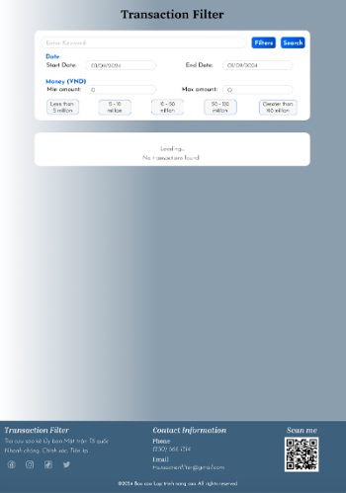
UI
No transactions found

Slide 10

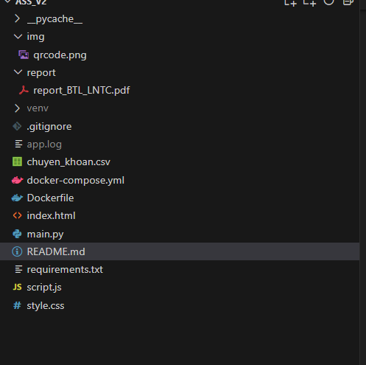
Source Code
Source Code Structure

Slide 11


DATA STRUCTURES AND ALGORITHMS
Pandas DataFrame is a structure that holds two-dimensional data and its corresponding labels. DataFrames are widely used in data science, machine learning, scientific computing, and many other data-intensive fields.
Pandas DataFrames are data structures that contain:
Data is organized in 2-dimensional space including rows and columns
Labels correspond to rows and columns

Slide 12
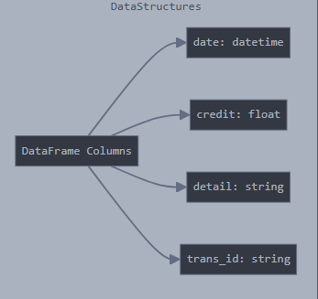
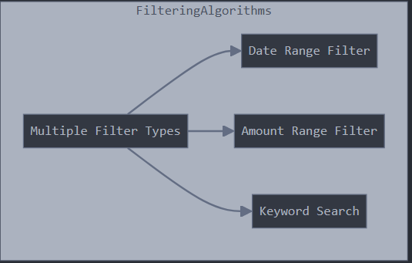
Data structures and algorithms

Slide 13

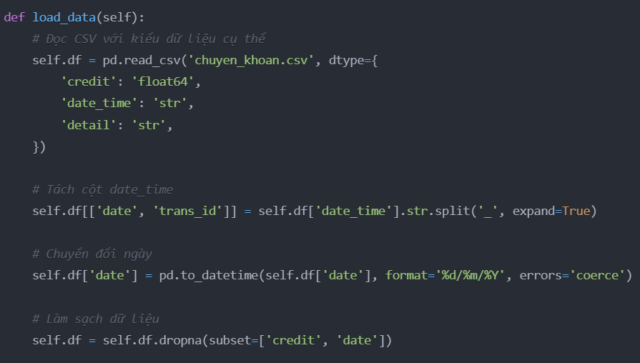
XỬ LÝ DỮ LIỆU
Nạp và Làm Sạch Dữ Liệu:

Slide 14
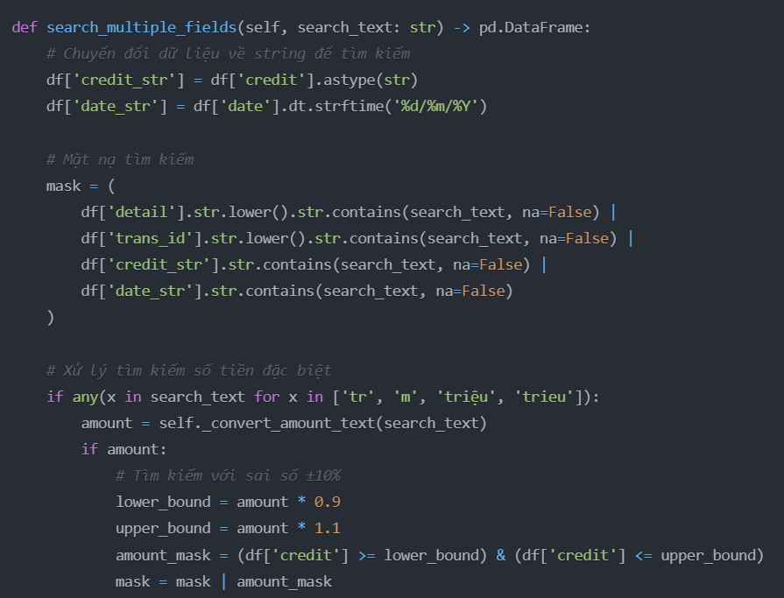
XỬ LÝ DỮ LIỆU
Giải Thuật Tìm Kiếm Đa Trường:

Slide 15
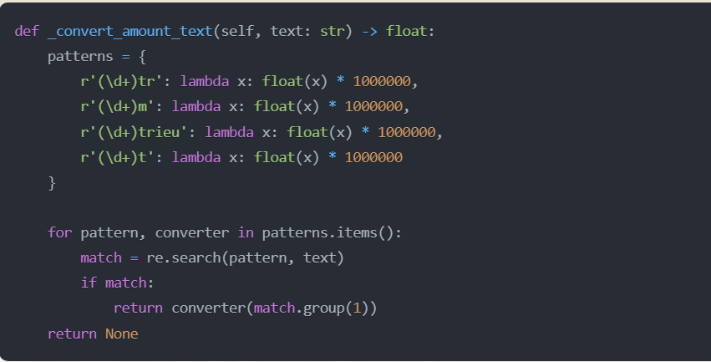
XỬ LÝ DỮ LIỆU
Giải Thuật Chuyển Đổi Số Tiền:

Slide 16






CHIẾN LƯỢC LỌC DỮ LIỆU
HỖ TRỢ NHIỀU TIÊU CHÍ LỌC ĐỒNG THỜI
LỌC THEO KHOẢNG NGÀY
LỌC THEO KHOẢNG SỐ TIỀN
LỌC THEO TỪ KHÓA
KẾT HỢP NHIỀU BỘ LỌC

Slide 17

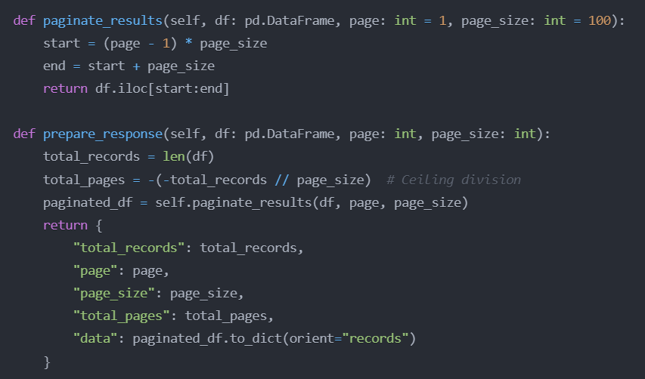
KỸ THUẬT PHÂN TRANG

Slide 18






































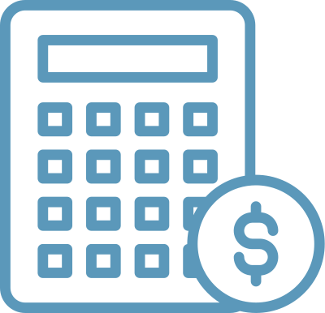





DEMO

Slide 19


GROUP 495
THANK YOU!
for listening to our presentation
We appreciate your time and look forward to your feedback to improve our project

